Slide 1
Galveston County Consolidation Drainage District’s (GCCDD) Goal, Maintenance, and Projects

Slide 2
Goal
Maintain zero net increase in runoff due to development. Construct and maintain facilities that will contain a 100 year storm runoff in the Clear Creek and Dickinson Bayou watershed which includes the following:
Clear Creek Medera Ditch
Chigger Creek Dickinson By-Pass
Cowards Creek White Hall/Anna Lea Ditch
Mary’s Creek Eagle Creek
Coyote Creek Mustang Ditch
Box Ditch Your Ditch
Dickinson Bayou Lundy Ditch
Volmar Ditch

Slide 3
Maintenance
Mowing & Spraying
Clearing Obstruction & Desnagging
Desilting
Erosion Prevention
Erosion Repair

Slide 4
Maintenance
Mowing & Spraying
Mowing and spraying 160 miles of creeks and 180 acres of detention basins are significant activities for GCCDD.
Mowing and spraying up to 50 feet on both creek banks is done to control vegetation that can restrict water flow.

Slide 5
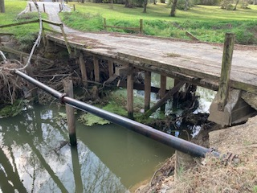
Maintenance
Removing Obstructions & Desnagging
Places like the foot bridge across Mary’s Creek accumulate debris and requires cleaning to maintain maximum water flow.

Slide 6
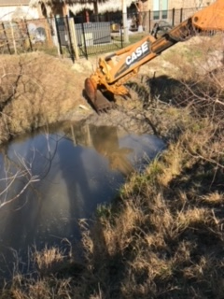
Maintenance
Desilting
After years, dirt in the storm water will settle on the bottom of drainage ditches. This requires silt removal to maintain the water flow capacity of the ditches.

Slide 7
Maintenance
Erosion Prevention
When a creek makes a severe directional change, it can result in bank erosion.
Various methods are used to prevent bank erosion. An example of erosion prevention is the concreted bank on Coward’s Creek.

Slide 8
Maintenance
Erosion Repair
The low water crossing on Mary’s Creek has failed resulting in significant erosion of the bank.
The eroded bank will be repaired using packed clay.
A single span bridge will be built to replace the low water crossing.

Slide 9
Projects
Development Standards
Development Reviews Approval
Purchasing Land for Detention Opportunity
Baker Road Regional Detention Basin
Chigger Creek Regional Detention
Harold Whitaker Storm Water Detention Basin at 1776 Park
Clearview Detention Basin
Mary’s Creek foot bridge replacement
FM 1959 Detention Basin
Cooperate with other governmental bodies to improve drainage

Slide 10
Projects
Development Standards
GCCDD has developed a set of engineering storm water drainage standards that developers must follow to ensure that no new development project increase storm water flow to the creeks.

Slide 11
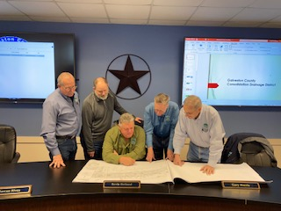
Projects
Development Reviews & Approval
The GCCDD’s Manager, Engineers, and Directors meet every 2nd and 4th Tuesday of the month to review, comment on, approve or deny new construction projects for compliance with the GCCDD Engineering standard requirements.

Slide 12
Projects
Purchasing Land for Detention Opportunity
The City of Friendswood and GCCDD look for opportunities to purchase land on the creeks that will provide additional storm water storage.
Most of the existing land used for storm water storage was purchased via the flood buy out program, which includes the Clearview and Harold Whitaker Storm Water Detention areas.

Slide 13
Projects
Baker Road Regional Detention Basin
The storm water basin is located on Coward’s Creek. It was built and is managed by the GCCDD.
The basin can hold 300 acre feet of water. An acre foot is the amount of water required to cover 1 acre of land 1 foot deep.
The basin is an example of off-line storm water storage. Off-line storage allows flood stage creek water to enter the basin and remain captured until the flooding threat has decreased. Then the water is allowed to flow back into the creek.

Slide 14
Projects
Chigger Creek Regional Detention Basin
The 33 acre basin was built and is managed by the GCCDD.
The basin has a capacity of 250 acre feet of water.
Chigger Creek Basin is an off-line storm water storage facility which captures water during creek flooding and release it when the flooding threat has dissipated.

Slide 15
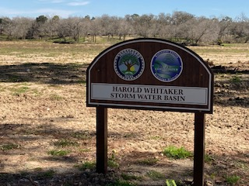
Projects
Harold Whitaker Storm Water Basin
This Clear Creek in-line storage area was a joint effort between the City of Friendswood and the GCCDD. It was built by removing 110,000 truck loads of dirt. The resulting capacity is 800 acre feet of storage.
In-line storage is achieved by lowering the creek bank to the ordinary high water level and moving the bank away from the creek channel.

Slide 16
Projects
Clearview Detention Basin
The south bank of Clear Creek at the end of Clearview is being lowered to the normal high water level and moved away from the creek channel.
40 acre feet of in-line storage is achieved by this project.

Slide 17
Projects
Mary’s Creek Foot Bridge Replacement
Since the existing Mary’s Creek foot bridge accumulates debris, it needs to be replaced with a higher free span bridge to ensure maximum creek flow.

Slide 18
Projects
Quakers Landing Project
The project will remove dirt and vegetation from Galveston County side of Clear Creek, which will move the bank away from the creek bed allowing for 20-acre ft. of inline storage.

Slide 19
Projects
FM 1959 Road Detention Basin
The FM 1959 storm water storage project is an off-line storage project achieved by removing trees, bushes, and dirt from the Harris County side of Clear Creek located between FM 1959 and Timber Creek Golf Course.
It will provide approximately 1,000-1,800-acre feet of storm water storage which will double the current GCCDD detention storage capacity.
Other Partners involved in the project are:
Harris County Drainage District
City of Friendswood
Galveston County

Slide 20
Potential Future Projects for Clear Creek totaling $135,250,000
Forest of Friendswood Detention Pond - $10,000,000
Clearing and De-snagging - $1,000,000
Clear Creek Slope Improvements
Phase 1 – FM 2351 to Second Detention Pond - $10,000,000
Phase 2 – Second Detention Pond to Golf Course - $25,000,000
Phase 3 – Golf Course to Banfield’s - $35,000,000
Phase 4 – Banfield’s to Dixie Farm Road - $45,000,000
Phase 5 – Downstream of Whispering Pines - $5,500,000
Phase 6 – FM 1959 Detention - $3,750,000

Slide 21
Potential Future Projects for Coward’s Creek - $5,000,000
Slope repairs upstream of Baker Road - $350,000
Slope repairs downstream of Baker Road - $350,000
Slope repair at the Nye property - $300,000
Slope repairs upstream of FM 518 - $350,000
Slope repairs downstream of Castlewood - $400,000
Russo property in–line detention - $2,000,000
Shadwell property in-line detention - $1,250,000

Slide 22
Potential Future Projects for Chigger Creek - $2,500,000
Slope repairs downstream of St. Cloud to Windsong - $425,000
Slope repairs downstream of Windsong to Greenbriar - $525,000
Slope repairs of Greenbriar to FM 528 - $300,00
Slope repairs downstream of FM 528 to FM 518 - $425,000
Improvements downstream of FM 518 to Oak Drive - $325,000
Improvements downstream of Oak Drive to Clear Creek - $500,000

Slide 23
Potential Future Projects Mary’s Creek - $2,525,000
Slope repairs from FM 2351 downstream - $1,500,000
Baptist Church Improvements - $500,00
Slope repairs upstream of FM 2351 to Dunbar - $525,000

Slide 24
Projects
Cooperation with other governmental entities to improve drainage:
City of Friendswood
City of League City
City of Pearland
City of Dickinson
City of Santa Fe
Galveston County
Harris County
Brazoria County Drainage District 4
Corp of Engineers
TxDOT

